Slide 1

A Cell Phone-Based Remote Home Control System
SANKALCHAND PATEL COLLEGE OF ENGINEERING,VISNAGAR.
EC DEPARTMENT
YEAR :- 2012-2013
Prepared By:)
CHINTAN PATEL (090400111039)
KULDEEPSINH PARMAR (090400111080)
Faculty Advisor:
Prof. R.V.DAVE
EC Department.

Slide 2
Presentation Outline
INTRODUCTON
DEFINITION
APPLICATION
ASSUMPTION
SYSTEM COMPONENTS
TECHNICAL APPROACH
PROGRAMING LANGUAGE
ADVANTAGES
LIMITATIONS

Slide 3
Introduction:-
The rapid growth of wireless communication, motivated us touse mobile phones to remotely control a household appliance. In this paper we describe a remote appliance control system which can control different household appliances by sending an SMS message from a mobile phone. This controller is extremely handy at places where we have to control the ON and OFF switching of the devices but no wired connection to that place is available. The microcontroller would then control and device based on the information given to it. The proposed solution will need to be easy to use, simple, secure, robust and be useful on most mobile phones. In a GSM based system for home automation is described which uses voice commands for control. In voice commands for home automation is being described. In this paper we describe a simple remote home appliance controusing GSM SMS (Short Messaging Service).

Slide 4
What Is gsm?
Global System for Mobile (GSM) is a second generation cellular standard developed to better voice services and data delivery using digital modulation
GSM (Global System for Mobile Communications): It is a cellular communication standard.
SMS (Short Message Service) – a service available on most digital mobile phones that permit the sending of short messages (also known as text messaging service).

Slide 5
definition:-
TO design a system that allows users, upon authentication, to remotely control and monitor multiple home appliances using a cell phone-based interface.

Slide 6
Application:-
➢ Home appliances systems like :-
• Television system
• Air conditioner system
• Electronic ovean
• Digital watch
• Security system

Slide 7
➢ Industrial area like :-
Water level indicator
Temperature indicator
Lunch break timer
Ring bell or horn to signify start and end of shift
School bell timer ,ring bells for start and end of class
Count down timer
Shift start/End announcements in factories
Time operation for advertising boards
Control of electric power switching
ON/OFF for heaters,gates,elevators
Programmable timer for factory bells

Slide 8
Assumptions List:-
The user and control unit will establish communication via GSM
The cell phone and service provider chosen will support text messaging service
The user is familiar with text messaging on their cell phone
The cell phone will support storing text message templates within the cell phone’s memory
All service charges from service provider apply
The controlled appliances will have to have an electrical interface in order to be controlled by microcontroller

Slide 9
System Components:-
Cellular Phone
Cellular Module (SIM 300)
Microcontroller (Pic 16F877A)
Relays
Appliances to be Controlled

Slide 10
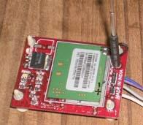
Cellular Module (SIM 300):-

Slide 11
Cellular Module (SIM 300):-
TRI-BAND GSM/GPRS module with a size of 40*3.3*5.5mm
Customized MMI and keypad lcd support
An embedded powerful TCP/IP support
Based upon mature and field-platform ,based up by SIMCON
support services ,form definition to design and production

Slide 12
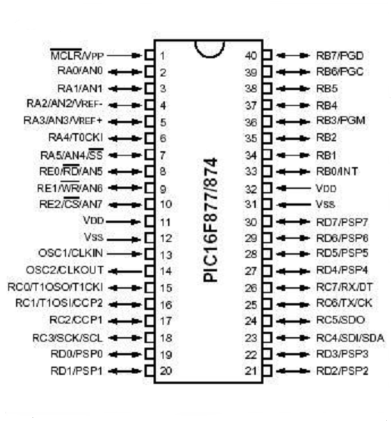
Microcontroller Selected:
(Pic 16F877A)

Slide 13
Features:-
RISC instruction set with only a handful of instructions to learn
Digital I/O ports
On-chip timer with 8-bit prescaler
Power-on reset
Watchdog timer
Power-saving SLEEP mode
High source and sink current
Direct, indirect, and relative addressing modes
External clock interface
RAM data memory
EPROM or Flash program memory
Brown-out detection circuitry for brown-out Reset(BOR)
Low-power, high-speed Flash/EEPROM technology
Wide operating voltage range (2.0V to 5.5V)

Slide 14
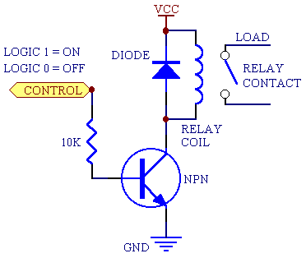
Relays:-
A relay is a simple electromechanical switch made up of anelectromagnet and a set of contacts. Relays are found hidden in all sorts of devices. In fact, some of the first computers ever built used relays to implement Boolean gates.
Control high voltage circuitry using low voltages; therefore compatible both with the fan and light’s power supply circuitry and the microcontroller’s circuitry
Higher cost than CMOS integrated circuits
Some types or relays dissipate static power

Slide 15
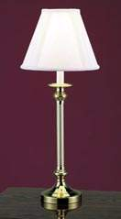
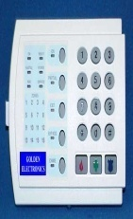
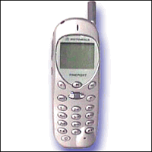
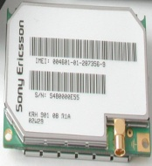
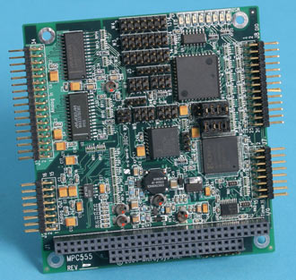
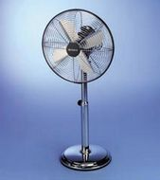
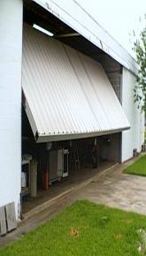
Circuit diagram:-
Lamp
Security System
Micro controller
Send completion status
Appliances
Send status
Send status
Perform required
instructions
Send message
Send message
Issue command
GSM chip
Fan
Garage Door
Cell Phone
Send text message
Receive status
message
Communicate with network
Transfer data to
microcontroller
Decode incoming message
Send instruction to appliance
Monitor completion status

Slide 16
Technical approach:-
The remote user sends command in CODED language with authentication information and commands to the GSM receiver.
The receiver receives messages sent from user cell phone.
GSM receiver parses the string for the authentication information, and the commands.
GSM receiver sends the commands to the microcontroller.
Microcontroller issues commands to the concerned appliance.
Microcontroller checks for implementation of command given and sends the confirmation to the sender.

Slide 17
Programming Languages:-
The software developed for this project will be loaded into the memory of the Pic 16F877A microcontroller.
The Pic 16F877A ’s compiler supports C and Assembly Language Programming. Programme written in Java and C++ are also permitted because their codes can be converted into C language.
Reason for Selecting C LanguageThe are:
Ease of development
NO. of Resources are availiable on internet.
Team members have experience coding C

Slide 18
Advantage:-
Convenience – SMS technology is easy to use and learn and can be accessed easily when needed.
Accessibility – instructions can be sent to the microcontroller to be controlled and monitored from any location provided there is the existence of an active GSM network or control from anywhere in world if cellular coverage is available.
Portability – a microcontroller can be controlled and monitored from any GSM phone that supports SMS. Considering the fact that most GSM phones support SMS, the system is therefore highly portable.
Saves Time – an SMS based remote monitoring and computer control systemsaves time as the user is not required to gain access to an internet connection or make a dedicated connection to the computer to be controlled as opposed to a Bluetooth-based system or an Internet based system.
Cheaper – SMS services are generally cheap and are sometimes provided for free (at least for certain periods) by service providers. Furthermore, most service providers do not charge users for receiving SMS.

Slide 19
Limitations:-
The receiver must reside in a location where a signal with sufficient strength can be received from a cellular phone network.
The only person who can communicate with the control module is the person who will be successfully authenticated.
Only devices with electrical controlling input ports will be possible targets for control.
The controlled devices will have I/O ports that will make communication with the receiver possible.
The receiver must have a power source (120V) attached at all times.
Operation of the controlling unit is only possible through a cell phone with SMS messaging capabilities.
The controlling unit must be able to receive and decode SMS messages.

Slide 20
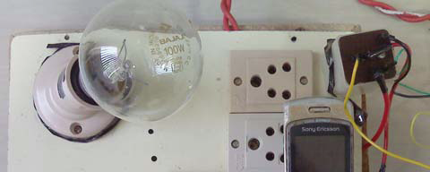
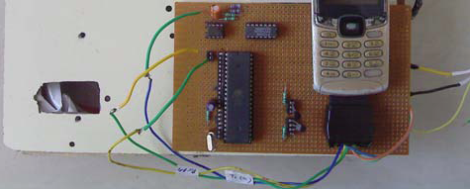

Slide 21
THANK YOU

